Slide 1


A Project Stage-I : Seminar on “ IOT based smart wearable device to monitor covid -19 patients remotely.”
By:
1)Sakshi Maskar
Roll no. 4134
2)Madhvi Mote
Roll No.4235
3)Yadnesh Kayande
Roll no.4136
Guided By:
Prof.V.P.Patil
Department Of E&TC
Jayawantrao Sawant College Of Engineering, Pune.

Slide 2
CONTENTS
Introduction
Literature Survey
Objective
Block Diagram and Description
Circuit Diagram
Algorithm
Specifications of proposed system
Advantages
Applications & Future scope
Conclusion

Slide 3
INTRODUCTION
Monitoring and managing the infected patients of COVID-19 is still a great challenge, hence we have proposed a system which is used to monitor the Covid-19 health symptoms of infected patients in the hospitals & at public transport from remote locations. The system involves smart body sensor & IoT based application peripheral interface. The system is useful to reduce the stress of medical staff and provide a means of communication between doctors, medical authorities, and family respondents. Smart sensor is used to measure temperature, heartbeat, SpO₂, and cough count. The
Application peripheral interface is used to update the health symptoms of the patient in real time. Internet of things technologies allows collecting, monitoring, managing, and analysing the disease symptoms remotely. If any patient breaks rules and wonder outside the defined area, proposed system is able to locate the patient and inform to medical authorities in real time.

Slide 4
LITERATURE SURVEY
SR.NO. | Title Name | Author’s Name | Year of Publication | Inference
1. | IoT based solution to provide indoor safety through social distancing, mask detection and temperature sensing contact less | Petrovic et al. IcETRAN | 2020 | Accuracy and frame rate for mask detection, social distance, and temperature sense
2. | 1. IoT based invariant fall detection system in real time. 2. Alert system to rescue individuals and provide medical assistance | Nooruddin et al., Elsevier, 2019 | 2019 | Workflow model used in development and deployment stages as data collection, preprocessing, model creation, training and testing and deploying model in the server
3. | 1. Body Area sensor IoT system to collect data in providing early warning of cardiac Arrest. 2.Low power communication module to collect temperature and heart rates on smart phone | AKM Jahangir Alam Majumder, Hindawi | 2019 | Healthy and unhealthy test performance with ECG signal analysis. Galvanic skin response and accelerometer

Slide 5
OBJECTIVES
This is combined solution used to monitor the patient remotely in convenient manner to alert and notify the medical authorities in case of emergency and on violation of self-quarantine rules.
This system can be made compulsory in schools, colleges & at public transport where there are maximum chances of infection.
To develop health monitoring system i.e. it
measures body temperature and heart rate.
To design a system to store the patient data over a
period of time using cloud.
To do analysis of collected data of sensors.

Slide 6
WORKING PRINCIPLE
The proposed system introduces security of health care and cloud of things. System works in two major parts viz. storage stage and data retrieving stage. In storage stage, data is stored, updated for future use. In data retrieving stage, retrieve data from cloud. The cloud server can share with authenticated user as per request.
Our system continuously monitoring patient’s vital signs and sense abnormalities. The monitored data is delivered to medical staff. Upon encountering abnormalities, the system alerts the medical staff about the abnormal parameter. Thus, reduces the need for manual monitoring done by the medical staff.
Our proposed system uses arduino with esp8266 to send data from sensors to cloud platform that is thing speak. Arduino has been programed with esp8266 module which includes the API key provided by on the things peak site. Any number users can see the medical record recorded on the thing speak using the thing speak access key.

Slide 7
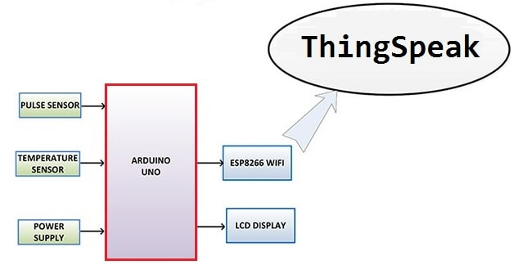
Block Diagram

Slide 8
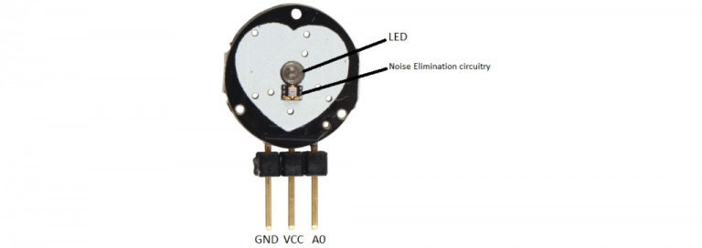
Details of each block Pulse sensor
The Pulse Sensor is a plug-and-play heart-rate sensor for Arduino. It can be used by students, artists, athletes, makers, and game & mobile developers who want to easily incorporate live heart-rate data into their projects. The essence is an integrated optical amplifying circuit and noise eliminating circuit sensor. Clip the Pulse Sensor to your earlobe or fingertip and plug it into your Arduino, you can ready to read heart rate. Also, it has an Arduino demo code that makes it easy to use.
The pulse sensor has three pins: VCC, GND & Analog Pin.
Specifications - Its diameter is 0.625
Its thickness is 0.125
The operating voltage is ranges +5V otherwise +3.3V
This is a plug and play type sensor
The current utilization is 4mA

Slide 9
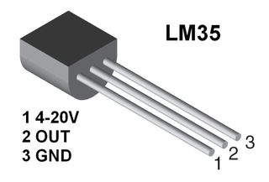
LM35 Temperature Sensor:
The LM35 series are precision integrated-circuit temperature devices with an output voltage linearly-proportional to the Centigrade temperature. The LM35 device has an advantage over linear temperature sensors calibrated in Kelvin, as the user is not required to subtract a large constant voltage from the output to obtain convenient Centigrade scaling. The LM35 device does not require any external calibration or trimming to provide typical accuracies of ±¼°C at room temperature and ±¾°C over a full −55°C to 150°C temperature range.
Specifications - Voltage Input: 2.7V to 5.5V DC,Output range: 0.1V (-40°C) to 2.0V (150°C)
Temperature range: -40°C to 150°C / -40F to 302F 2°C accuracy
Outputs an analog voltage that is proportional to the ambient temperature

Slide 10
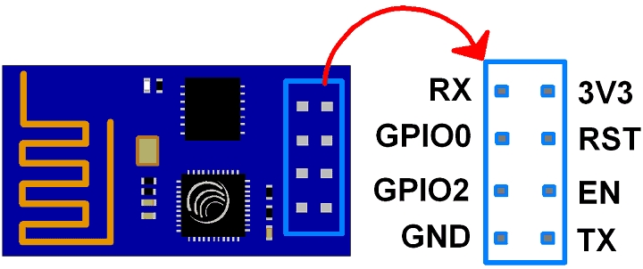
ESP8266:
The ESP8266 is a very user-friendly and low-cost device to provide internet connectivity to your projects. The module can work both as an Access point (can create hotspot) and as a station (can connect to Wi-Fi), hence it can easily fetch data and upload it to the internet making the Internet of Things as easy as possible. It can also fetch data from the internet using API’s hence your project could access any information that is available on the internet, thus making it smarter. Another exciting feature of this module is that it can be programmed using the Arduino IDE which makes it a lot more user-friendly
The ESP8266 module works with 3.3V only, anything more than 3.7V would kill the module hence be cautious with your circuits. Here is its pins description.
Specifications – Serial UART baud rate : 115200 bps, Input power 3.3v
I/p Voltage tolarence 3.6v max
Flash memory size 1 MB, 8 M bit
WiFi security modes – WPA, WPA2

Slide 11
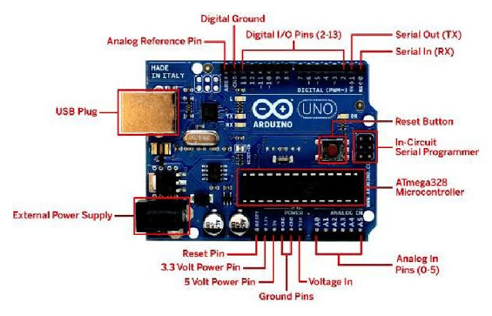
Arduino UNO Microcontroller Microchip ATmega328P Operating Voltage 5V USB Standard Type B Digital I/O Pins 14 PWM Digital I/O Pins 6 Analog Input Pins 6 Flash Memory 32 KB SRAM 2 KB EEPROM 1 KB Clock Speed 16 MH

Slide 12
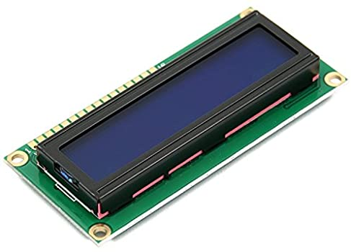
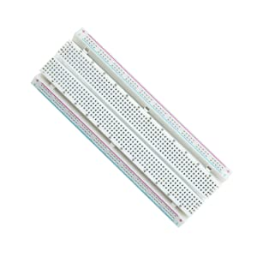
LCD Display Voltage: 5V DC LCD display type: Characters Module dimension: 80mm x 35mm x 11m JHD162A 16X2 LCD Display BreadBoard 830 tie points breadboards: 630 tie-point ic-circuit area plus 2x100 tie-point distribution strips providing 4 power rails. 400 tie points breadboards: 300 tie-point ic-circuit area plus 2x50 tie-point distribution strips providing 4 power rails. Wire size: Suitable for 20-29 AWG wires. Material: ABS Plastic Panel, Tin Plated Phosphor Bronze Contact Sheet. Voltage / Current: 300V/3-5A

Slide 13
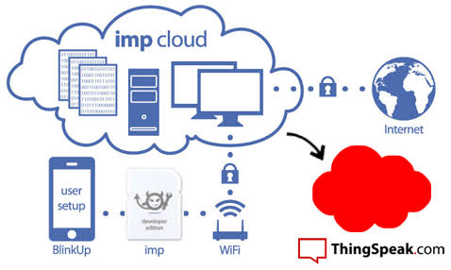
IOT Platform (Thing Speak) a) Use the Thing speak platform to send data to the cloud from any Internet-enabled device. b) You can then configure actions and alerts based on your real-time data and unlock the value of your data through visual tools. c) Use the Thing speak offers a platform for developers that enable them to easily capture sensors data and turn it into useful information d) Thing Speak server is an open data platform and API for the Internet of Things that enables you to collect, store, analyze, visualize, and act on data from sensors. e) Thing Speak is available as a free service for non- commercial small projects (<3 million messages/year or ~8,200 messages/day). Thing Speak is bought in units, where one unit allows 33 million messages to be processed and stored in a one-year period (~90,000 messages/day).

Slide 14
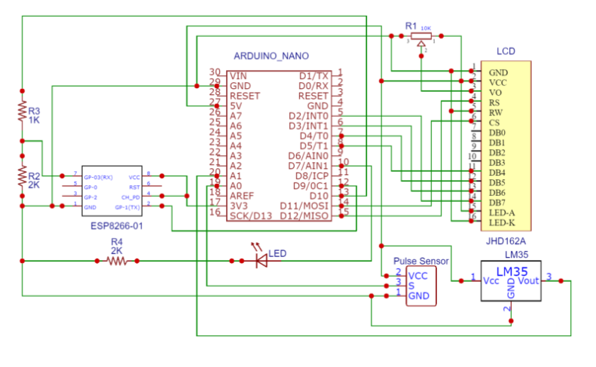
CIRCUIT DIAGRAM

Slide 15
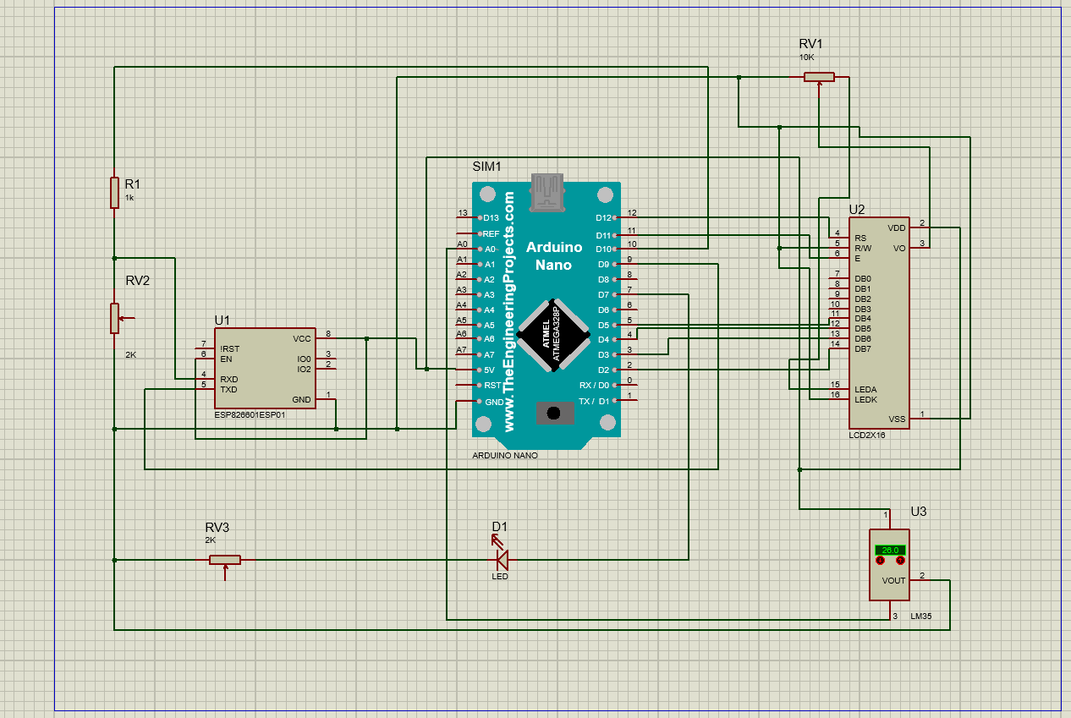
SIMULATION

Slide 16
Circuit diagram description
Connect Pulse Sensor output pin to A0 of Arduino and other two pins to VCC & GND.
Connect LM35 Temperature Sensor output pin to A1 of Arduino and other two pins to VCC & GND.
Connect the LED to Digital Pin 7 of Arduino via a 220-ohm resistor.
Connect Pin 1,3,5,16 of LCD to GND.
Connect Pin 2,15 of LCD to VCC.
Connect Pin 4,6,11,12,13,14 of LCD to Digital Pin12,11,5,4,3,2 of Arduino.
The RX pin of ESP8266 works on 3.3V and it will not communicate with the Arduino when we will connect it directly to the Arduino. So, we will have to make a voltage divider for it which will convert the 5V into 3.3V. This can be done by connecting the 2.2K & 1K resistor. Thus the RX pin of the ESP8266 is connected to pin 10 of Arduino through the resistors.
Connect the TX pin of the ESP8266 to pin 9 of the Arduino.

Slide 17
Bill of Material:
Arduino uno/nano bar
ESP8266-01 Wifi module
JHD162A 16×2 LCD display
Potentiometer 10k
Pulse sensor
LM35 Analog Temperature sensor
Resistor 1K and 2K
LED 5mm LED of any color
Connecting wires( 10 or 20)
Breadboard
FINAL COST – 5000.00

Slide 18
ADVANTAGES
It helps prevent spread of diseases.
System Is used to manage monitor covid-19 patients in hospitals remotely
It is quite simple and easy to use For the patients In hospital

Slide 19
APPLICATIONS & FUTURE SCOPE
Application:
Used at hospitals to monitor manage covid-19 patients remotely
Future Scope:
We can use this prototype and convert this system to wearable smart device
Also we suggest To use the wearable device as a prototype for the passengers of the airport to quarantine during their entry and exit.

Slide 20
CONCLUSION
Presently separate systems are available for monitoring patient health & sending an alert to medical authorities using a cloud data. We have proposed a combined system which will be useful to monitor all parameters in one dataset using Smart sensor, IOT & android application to provide alerts to family respondents.

Slide 21

Thank You!

